Slide 1
Cultivating Capital Creatively:
Financial & Social
Rebecca Thistlethwaite
www.rebeccathistlethwaite.com

Slide 2
What is Capital?
Financial - the financial resources available to invest in a business
Social - collective value of all social networks;
social networks have value

Slide 3
Types of Financial Capital
Fixed Capital - assets that will remain permanently with the business to help it earn income. Ex- land, buildings, greenhouses, processing plant, etc.
Working/Operating Capital - money used for running the business day to day.

Slide 4
Terms of Financial Capital
Short term - 1 yr. operating loans, CSA payments, credit cards, deposits, contracts, off-farm income
Medium term - term loans, leasing, lines of credit
Long term - mortgage, venture capital, equity, retirement accounts

Slide 5
Conventional Debt Financing
Short-term: credit cards, operating loan
Medium-term: bank loan, USDA loan, SBA loan,
line of credit
Long-term: mortgage, refinance, equity loan, USDA farm purchase loan

Slide 6
Unconventional Debt Financing
Friends & family loans
USDA REAP loans (energy efficiency or renewables)
Owner-financing
Loan-based crowdfunders- prosper.com, lendinclub.com

Slide 7
Investor/Equity Financing
Only pay back if you make a profit
Agree to give a % of profits (what profit??)
Requires extensive legal filings
Sell stock to individuals or firms
Mostly for fast-growing, high-revenue potential ventures like processed foods, specialized equipment, or web-based apps
Ex. Organic Valley Class E non-voting stock

Slide 8
Cooperative Financing
Each member-owner makes a financial contribution or a sweat-equity contribution or combo of both
Helps spread risk, more resistant to economic booms & busts, assures more stable supply
Owners receive annual patronage dividends or choose to reinvest back into business
Good way for small-scale producers to ‘scale-up’ & build necessary infrastructure

Slide 9
Grant Programs
Not free $- costs $ to apply, manage, report
Very competitive in most cases
Most reimburse for funds already spent- do you have cash flow for this?
Require good record-keeping, bookkeeping, & reporting
Ex. USDA REAP, Value Added, FMPP, CIG, EQIP, CSP, CRP, WRP, SARE, & others

Slide 10

www.usda.gov/knowyourfarmer

Slide 11
Crowdfunding
Donation-based programs (Kickstarter, Indiegogo)
Need to come up with gifts for donors
Need compelling idea, catchy video, good social media skills, media connections
Projects that benefit more than just one farm/business seems to garner more support

Slide 12
Buyer/Consumer Financing
CSA pre-purchases
Private Clubs/Membership Programs
Gift Certificates
Pre-paid contracts with buyers (wholesale/retail)
Consumer loans
Extended terms for key inputs

Slide 13
Why Social Capital?
Lending a hand
Lending money
Word of mouth marketing
Borrowing & bartering
Barn Raising!
Insurance Policy
Make friends and cooperators

Slide 14
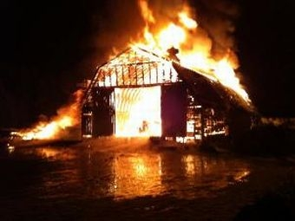
Pete’s Greens barn fire- Jan. 2011, Craftsbury, Vermont

Slide 15
Value of Social Capital
“Pete has a huge CSA, and a farmers’ market and self branded wholesale presence in Vermont. I think a lot has to do with the range of people who see themselves as connected to the farm—the size of the community from which the farmer can draw their support. For a dairy shipping milk, it seems that community is limited really to the people who personally know the farmer, whereas a direct-marketing farmer clearly has a much wider pool of people who feel invested in their farm.”

Slide 16
Social Capital
Take stock of your social networks
Consider volunteering
Join boards of directors, steering committees, etc.
Join chamber or other business group
Public speaking
Charitable donations
Representing your ‘brand’

Slide 17
Social Capital
Build a social media presence
Promote others, even competitors
Share your values, walk your talk
Farm tours, videos, etc. to build connection with consumers
Local media tour or local chef tour
School visits or bring kids out
Don’t be invisible - build a strong brand

Slide 18
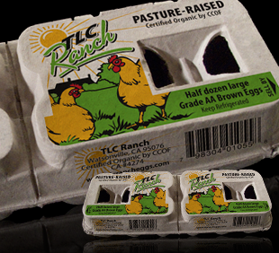
A few examples-
TLC Ranch
Off farm income
10K private loan
0% credit cards
CSA partnering
Egg Share program
3 private 10K loans
Adopt a Hen fundraiser

Slide 19
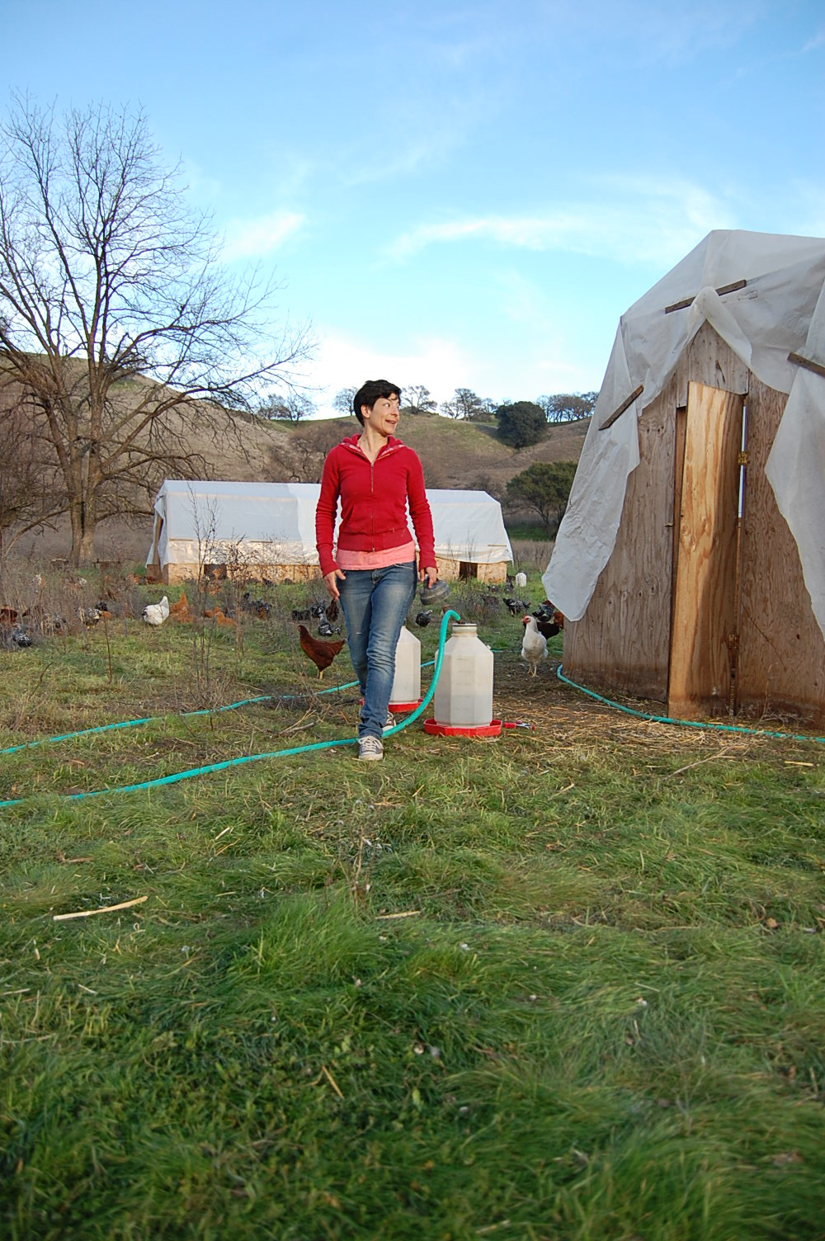
Soul Food Farm
Fire rebuild fundraisers at restaurants
Volunteer crew to rebuild chicken coops
$ raised to buy new birds
Egg Share program
Slow Money group loan

Slide 20
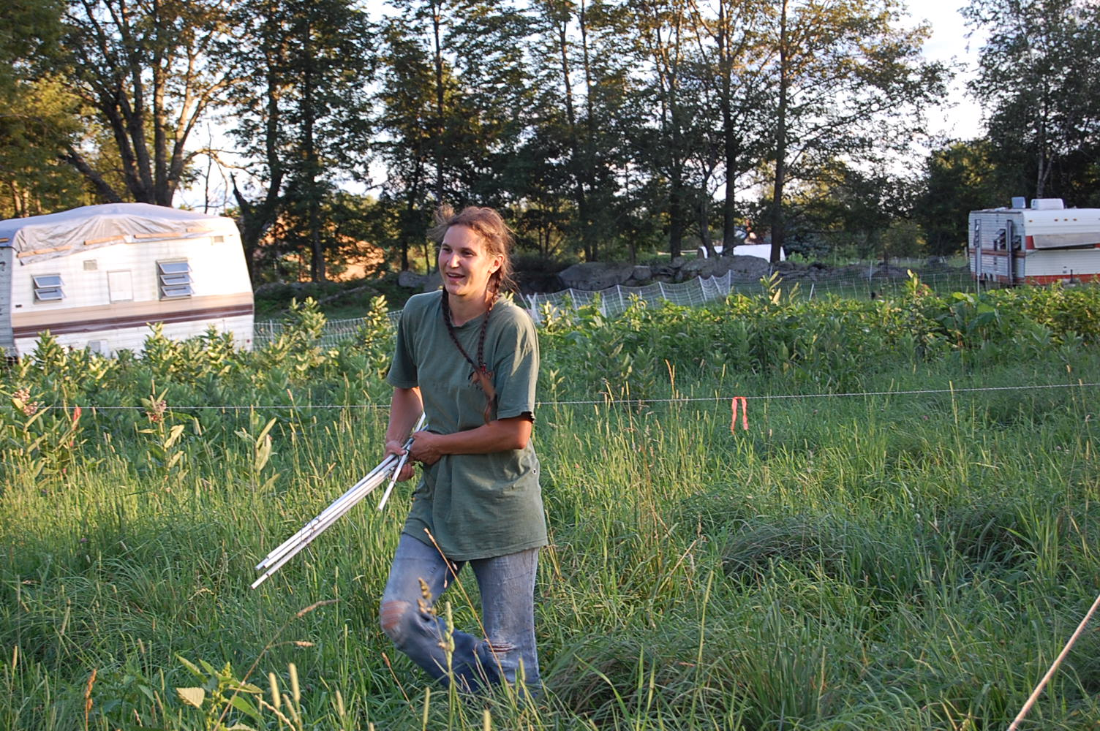
Misty Brook Farm
Volunteer crew for sudden move
0% credit cards
CSA prepayments
Private loans for house
House equity financing purchase of farmland

