Slide 1
I’m a Farmer,
Not an Entrepreneur
Rebecca Thistlethwaite
Author, “Farms With a Future”
Notes:
How many of you are farmers?
How many of your are business people?
Did the same people raise their hands? You should have…

Slide 2
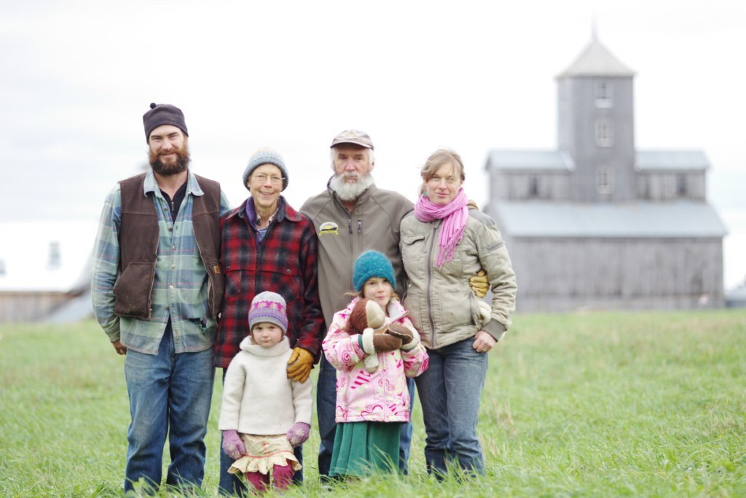
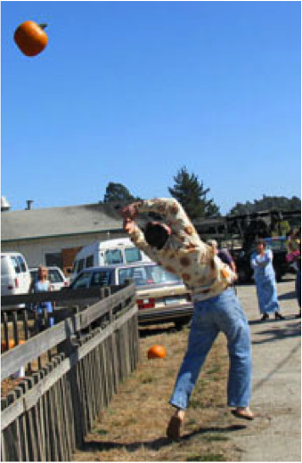
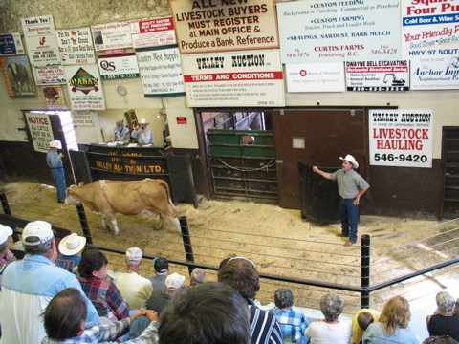
Wing it, Plan it, or Fail it
Notes:
Some of us wing it, & the lucky few survive.
Some of us fail, & we have to liquidate, declare bankruptcy, or sell off our land
But some of us, those who think like an entrepreneur, will plan our businesses well and succeed. Do you want to be in that camp?

Slide 3
Plan It!
Principles and Vision
Resources Available or Needed
Strategizing & Decision-Making
Identifying Market Niches
Build Social Capital & Brand Awareness
Accessing Capital
Look at Other Models/Continuous Learning
Notes:
These are some of the steps to being a savvy entrepreneurial farmer that I hope you have already taken or will spend this winter thinking about
-Start off with good visioning and declaring your principles
-Analyze your current resource base
-Brainstorm strategies and test those strategies
-Indentify your market position
-Develop brand awareness and build social capital at the same time
-Secure capital for short-term production and long-term viability
-Continue to learn and adapt your system

Slide 4
Visioning
Visioning and Goal-Setting (using Holistic Management Framework)
  Quality of Life Phrases
  Forms of Production
  Future Resource Base
Ex: My family and I will create and support health and wellness while pursuing our passions, caring for our community, and improving our environment.
Notes:
Quality of Life phrases- health, wellness, fun, play, connection, engagement, ecological, creative, etc.
Forms of Production- personal changes, social & cultural activities, or economic forms of production (what do you have to DO to manifest QofL?)
Future Resource Base- what must you, your family, your land, your community look like in future to support your QofL & Forms of Production?

Slide 5
Resource Analysis
SWOC Analysis (for entire operation & individual enterprises)
  Strengths
  Weaknesses
  Opportunities
  Challenges

Slide 6
SWOC (whole farm)
STRENGTHS -own land, small mortgage -off-farm income -biology, ecology backgrounds | WEAKNESSES -no extra capital -lots to do, little time to do it all
OPPORTUNITIES -barter economy -farmstand -other good farmers to collaborate with | CHALLENGES -small, local market -comp. from low-cost hobby farmers -limited infrastructure

Slide 7
Biz Strategizing
“A strategy is the means by which the business uses its strengths to take advantage of opportunities so the goals identified for the business can be realized.”
PHEW!
Now you have your goals, you’ve done your SWOC, now evaluate your different options. Do so by asking the following questions:

Slide 8
Testing Identified Strategies
Does this decision move the business toward or away from 3 part Holistic Goal?
Does this action maximize my strengths?
Does this action minimize a weakness & get to the root cause of it?
Does this action turn a challenge into an opportunity?

Slide 9
Brainstorm Strategies
Expand: Work with nearby orchardist to run animals in his orchards
Stability: Grow the same size garden & # of animals, just do it better
Retrench: Shrink size of garden & instead consign produce from other farmers
Exit: Sell farmstand & focus on homesteading activities

Slide 10
Enterprise Analysis
Profit Potential- net profits & net returns for labor
Synergies
Competitions (for labor, $, space, etc.)
Compatibility with land, climate, & people
Market potential
Barriers to entry & costs of exit

Slide 11
Market Planning
Who is your potential customer base?
Where is your potential customer base?
What are the current gaps in these markets?
What prices will those market bear?
Understanding market trends

Slide 12
Food Market Trends
Changing Demographics
Cooking at Home
A Return to ‘Americana’
More Natural, Less Processed
Rise in Functional Foods/Eating for Nutrients
Desserts & Retro Flavors Comeback

Slide 13
Food Market Trends continued…
Return to 3 Squares
More Home Entertaining
Value “Plus”
The Whole Package
We Love Animals
Local Yokel

Slide 14
Clarify & Communicate Your Values
Certified Organic
Antibiotic-Free, Hormone-Free
Grassfed or Pasture-Raised
Humane Animal Care Certifications
Fair Trade, Union Made, or Socially Just
Heritage or Heirloom Breeds/Varieties
Family-Farmed or Owner-Operated
Green Power, Draft Animal Power, etc.

Slide 18
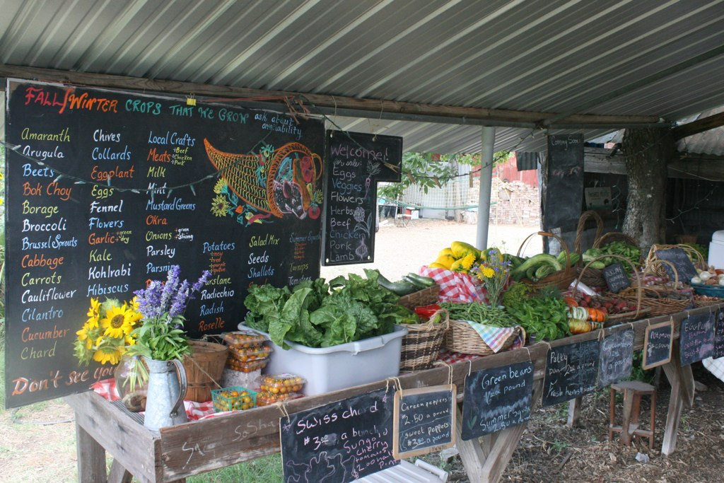
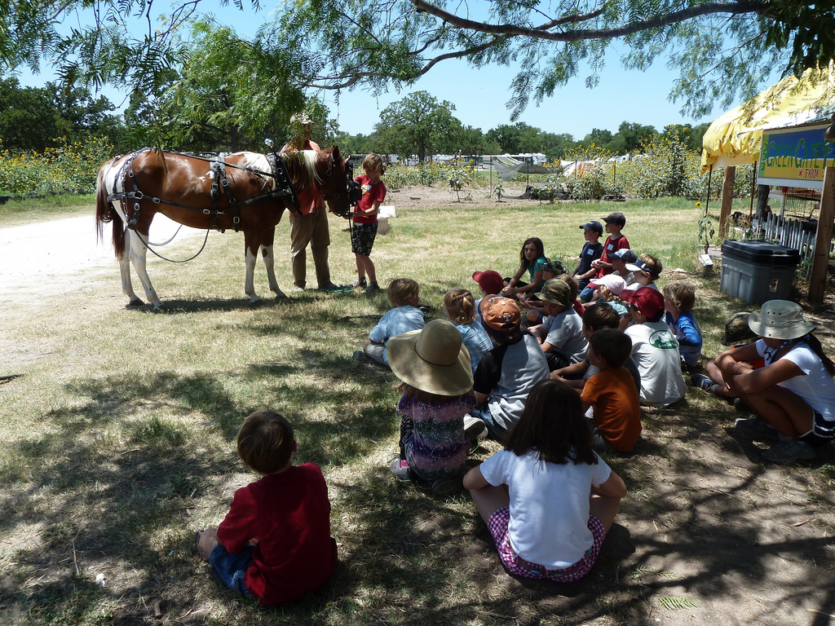
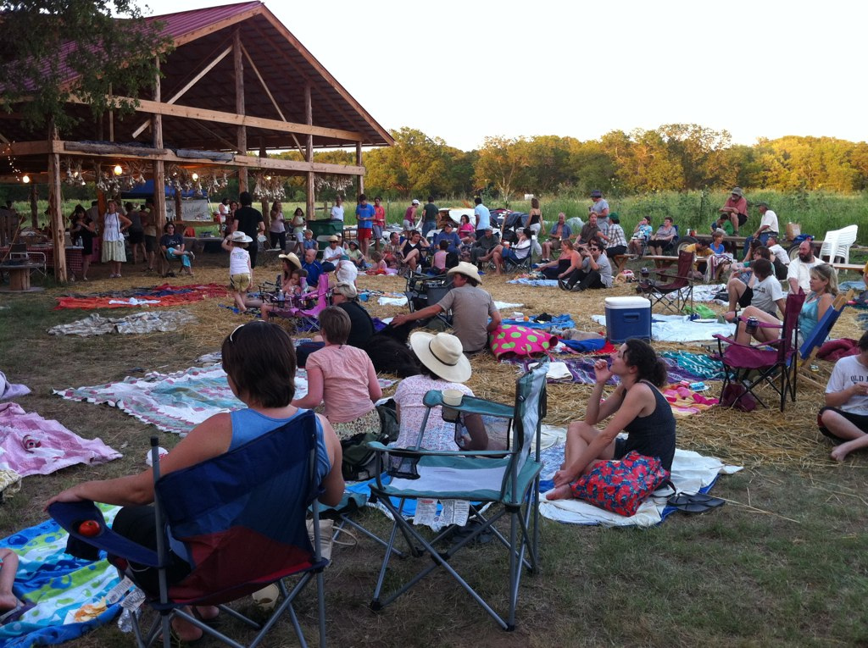
Social Capital
Notes:
Social capital is the value of all your human networks. Just like financial capital, it is something you can nurture & draw on when you need it. Unlike financial capital that depletes over time from use, social capital increases with use! Research has shown that farms with an identity & more direct relationships with their customers have better survivability!

Slide 19
Creative Financing
Money can come in these forms- loans, forward contracts, equity (future earnings), grants, donations, savings, & business earnings
Two classes of loan financing: working capital & long-term/asset capital
For start-up & growth phases, best to blend several types of funding to reduce risk & spread debt repayment

Slide 20
Alternative $ Sources
Low interest credit cards (short-term)
Your savings, your spouse’s income (get permission!)
Home refinancing (be careful on this one)
CSA shares, gift certificates, product prepayments, buyer loans
Private friends & family loans
Grants (VAPG, REAP, EQIP, state grants)
Kickstarter, Indiegogo, & LendingClub loans
Cooperative financing

Slide 21
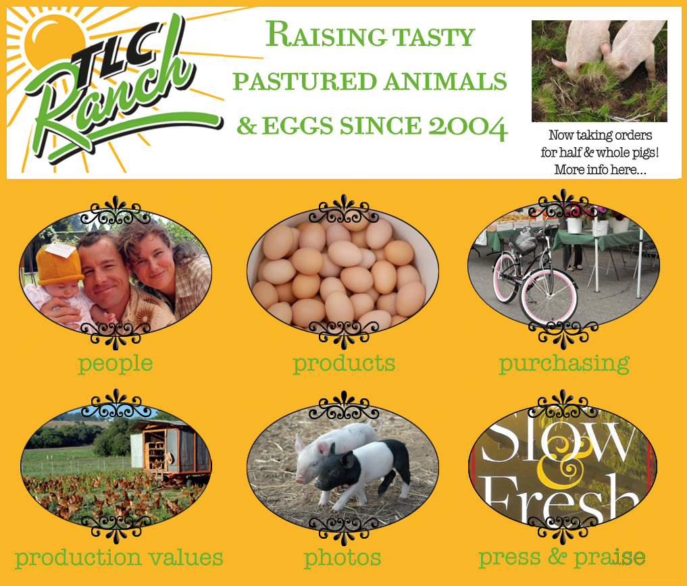
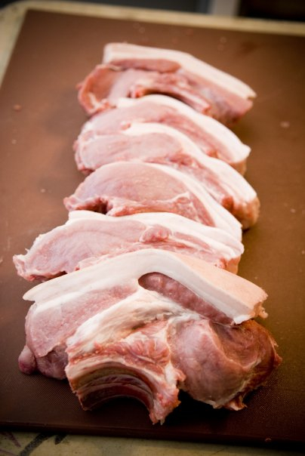
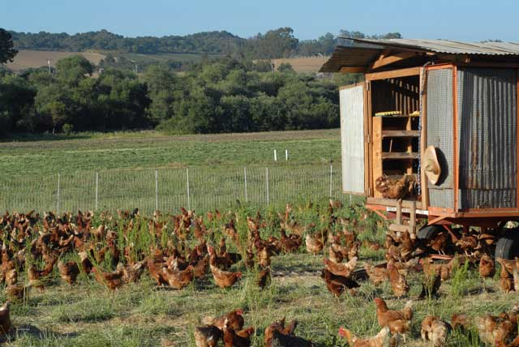
TLC Ranch, CA (2004-2010)

Slide 22
TLC Ranch Enterprises
First couple years raised broilers (10,000) & turkeys (100), selling all at farmers markets
12 sow, 2 boar farrow to finish operation, avg. 200 piglets. Purchased additional 50-100 weiners annually
Sold halves & wholes as well as retails cuts of pork
Raised 2,500-5,000 hybrid layers for eggs
Sold eggs at farmers markets, direct to stores, a couple select restaurants & bakeries, & to a large CSA
Finished 30 Dorper lambs each year & 6 Jersey steers every other year all on grass, selling retail cuts at our farmers market booth
Slaughter/Butcher classes in winter

Slide 23
TLC Ranch Highlights
No fertilizer, no medications, no castrating or body modifications, no tillage, no farm equipment, no buildings
All structures & fencing portable
Went from 10K first year to 430K by sixth year on just 20 acres of rented ground
Picked mix of enterprises based on gaps in market, compatibility with land, & low capital requirements
Sold the business for a profit
Restored the fertility of 50 year strawberry fields

Slide 24
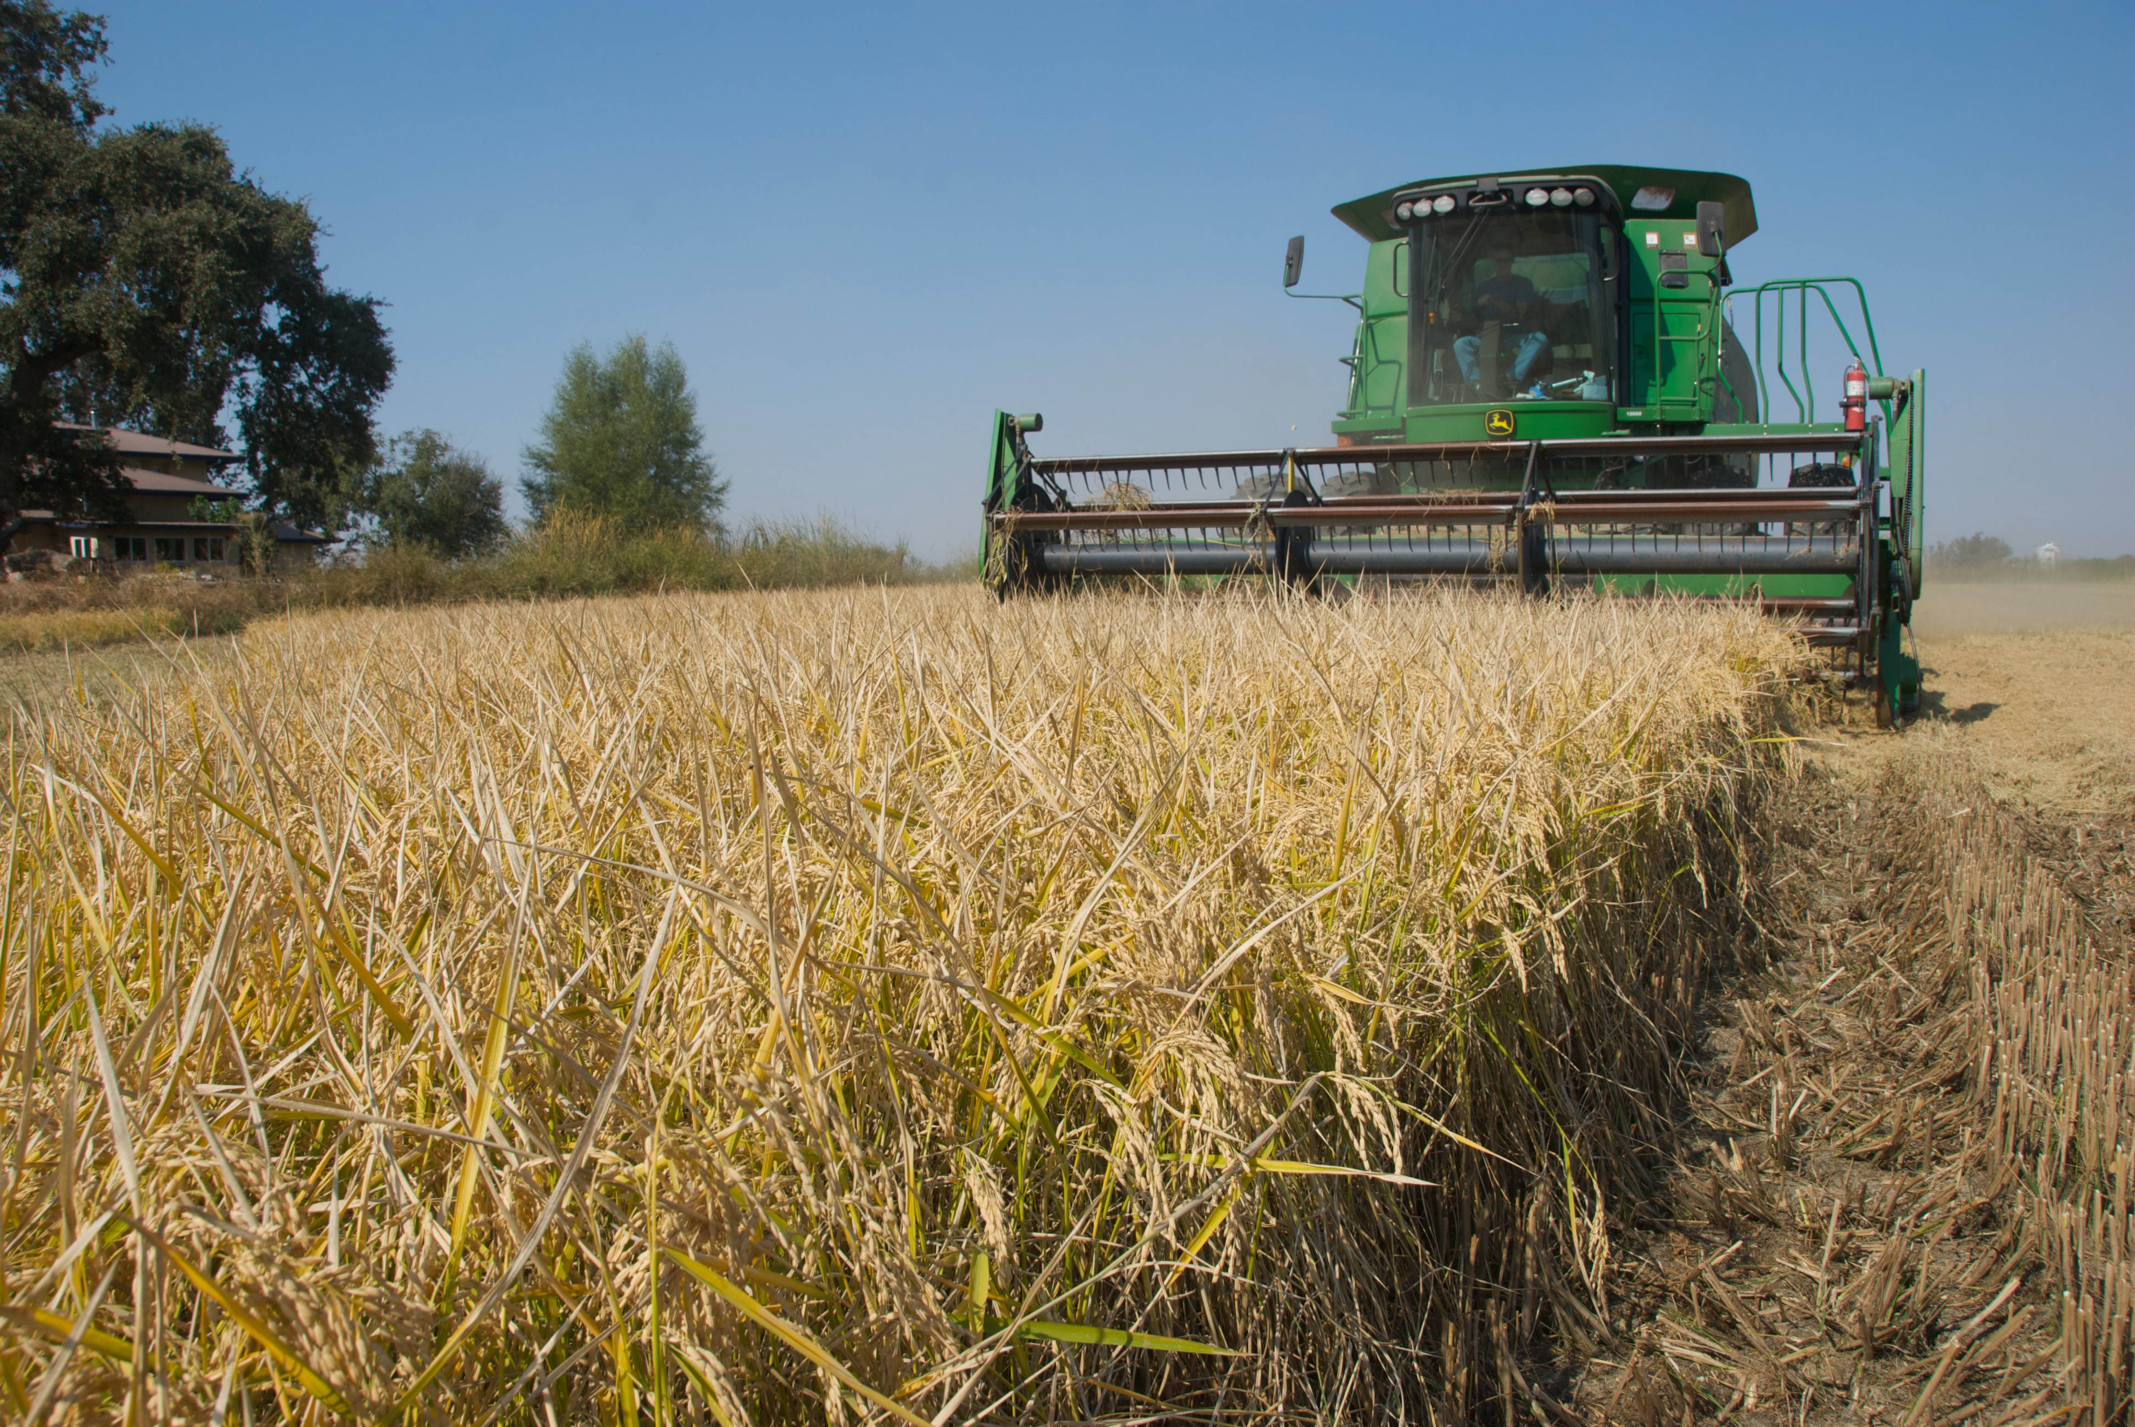
Massa Organics, CA

Slide 25
Massa Organics Highlights
Organic rice, wheat, alfalfa, hay
Organic almonds & almond butter
Organic duck, lamb, & pork
Production synergies & ecosystem thinking
Farmers Markets, Web Sales, Direct to Restaurant, Wholesaling
Social media savvy, farm tours

Slide 26
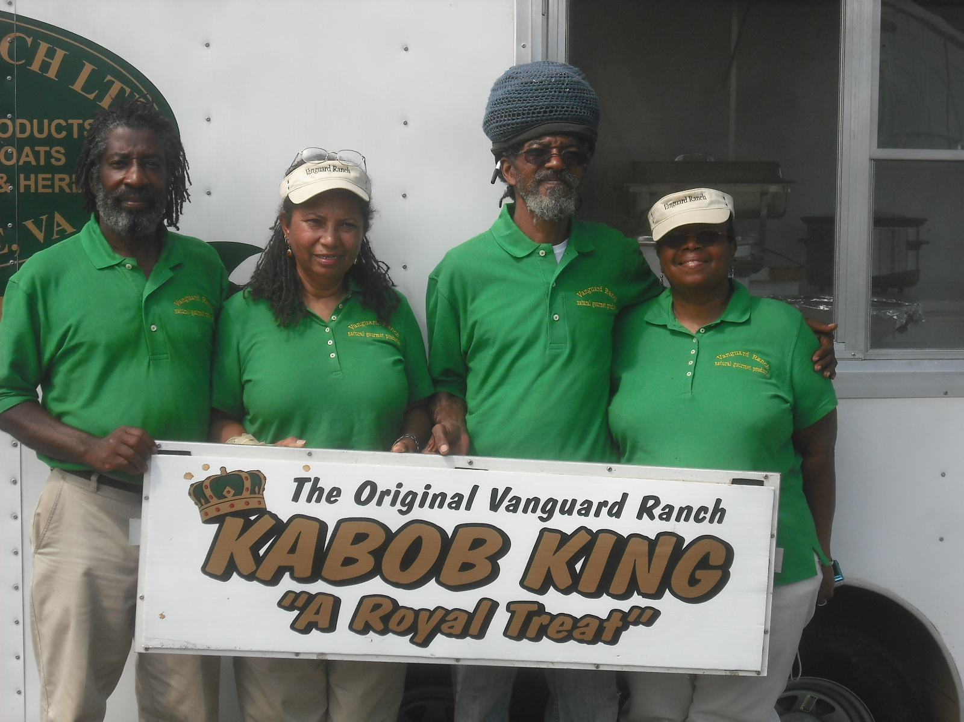
Vanguard Ranch, VA

Slide 27
Vanguard Ranch Highlights
Pastured goats
Myotonic breed (hardy, parasite resistant)
Value-Added goat meat dishes
Raise their own herbs, spices, & veggies for the dishes
Concession Trailer for fairs, festivals, etc.
Averages $36-38/lb. for goat meat
Collaborate with Virginia State U. on pasture research

Slide 28
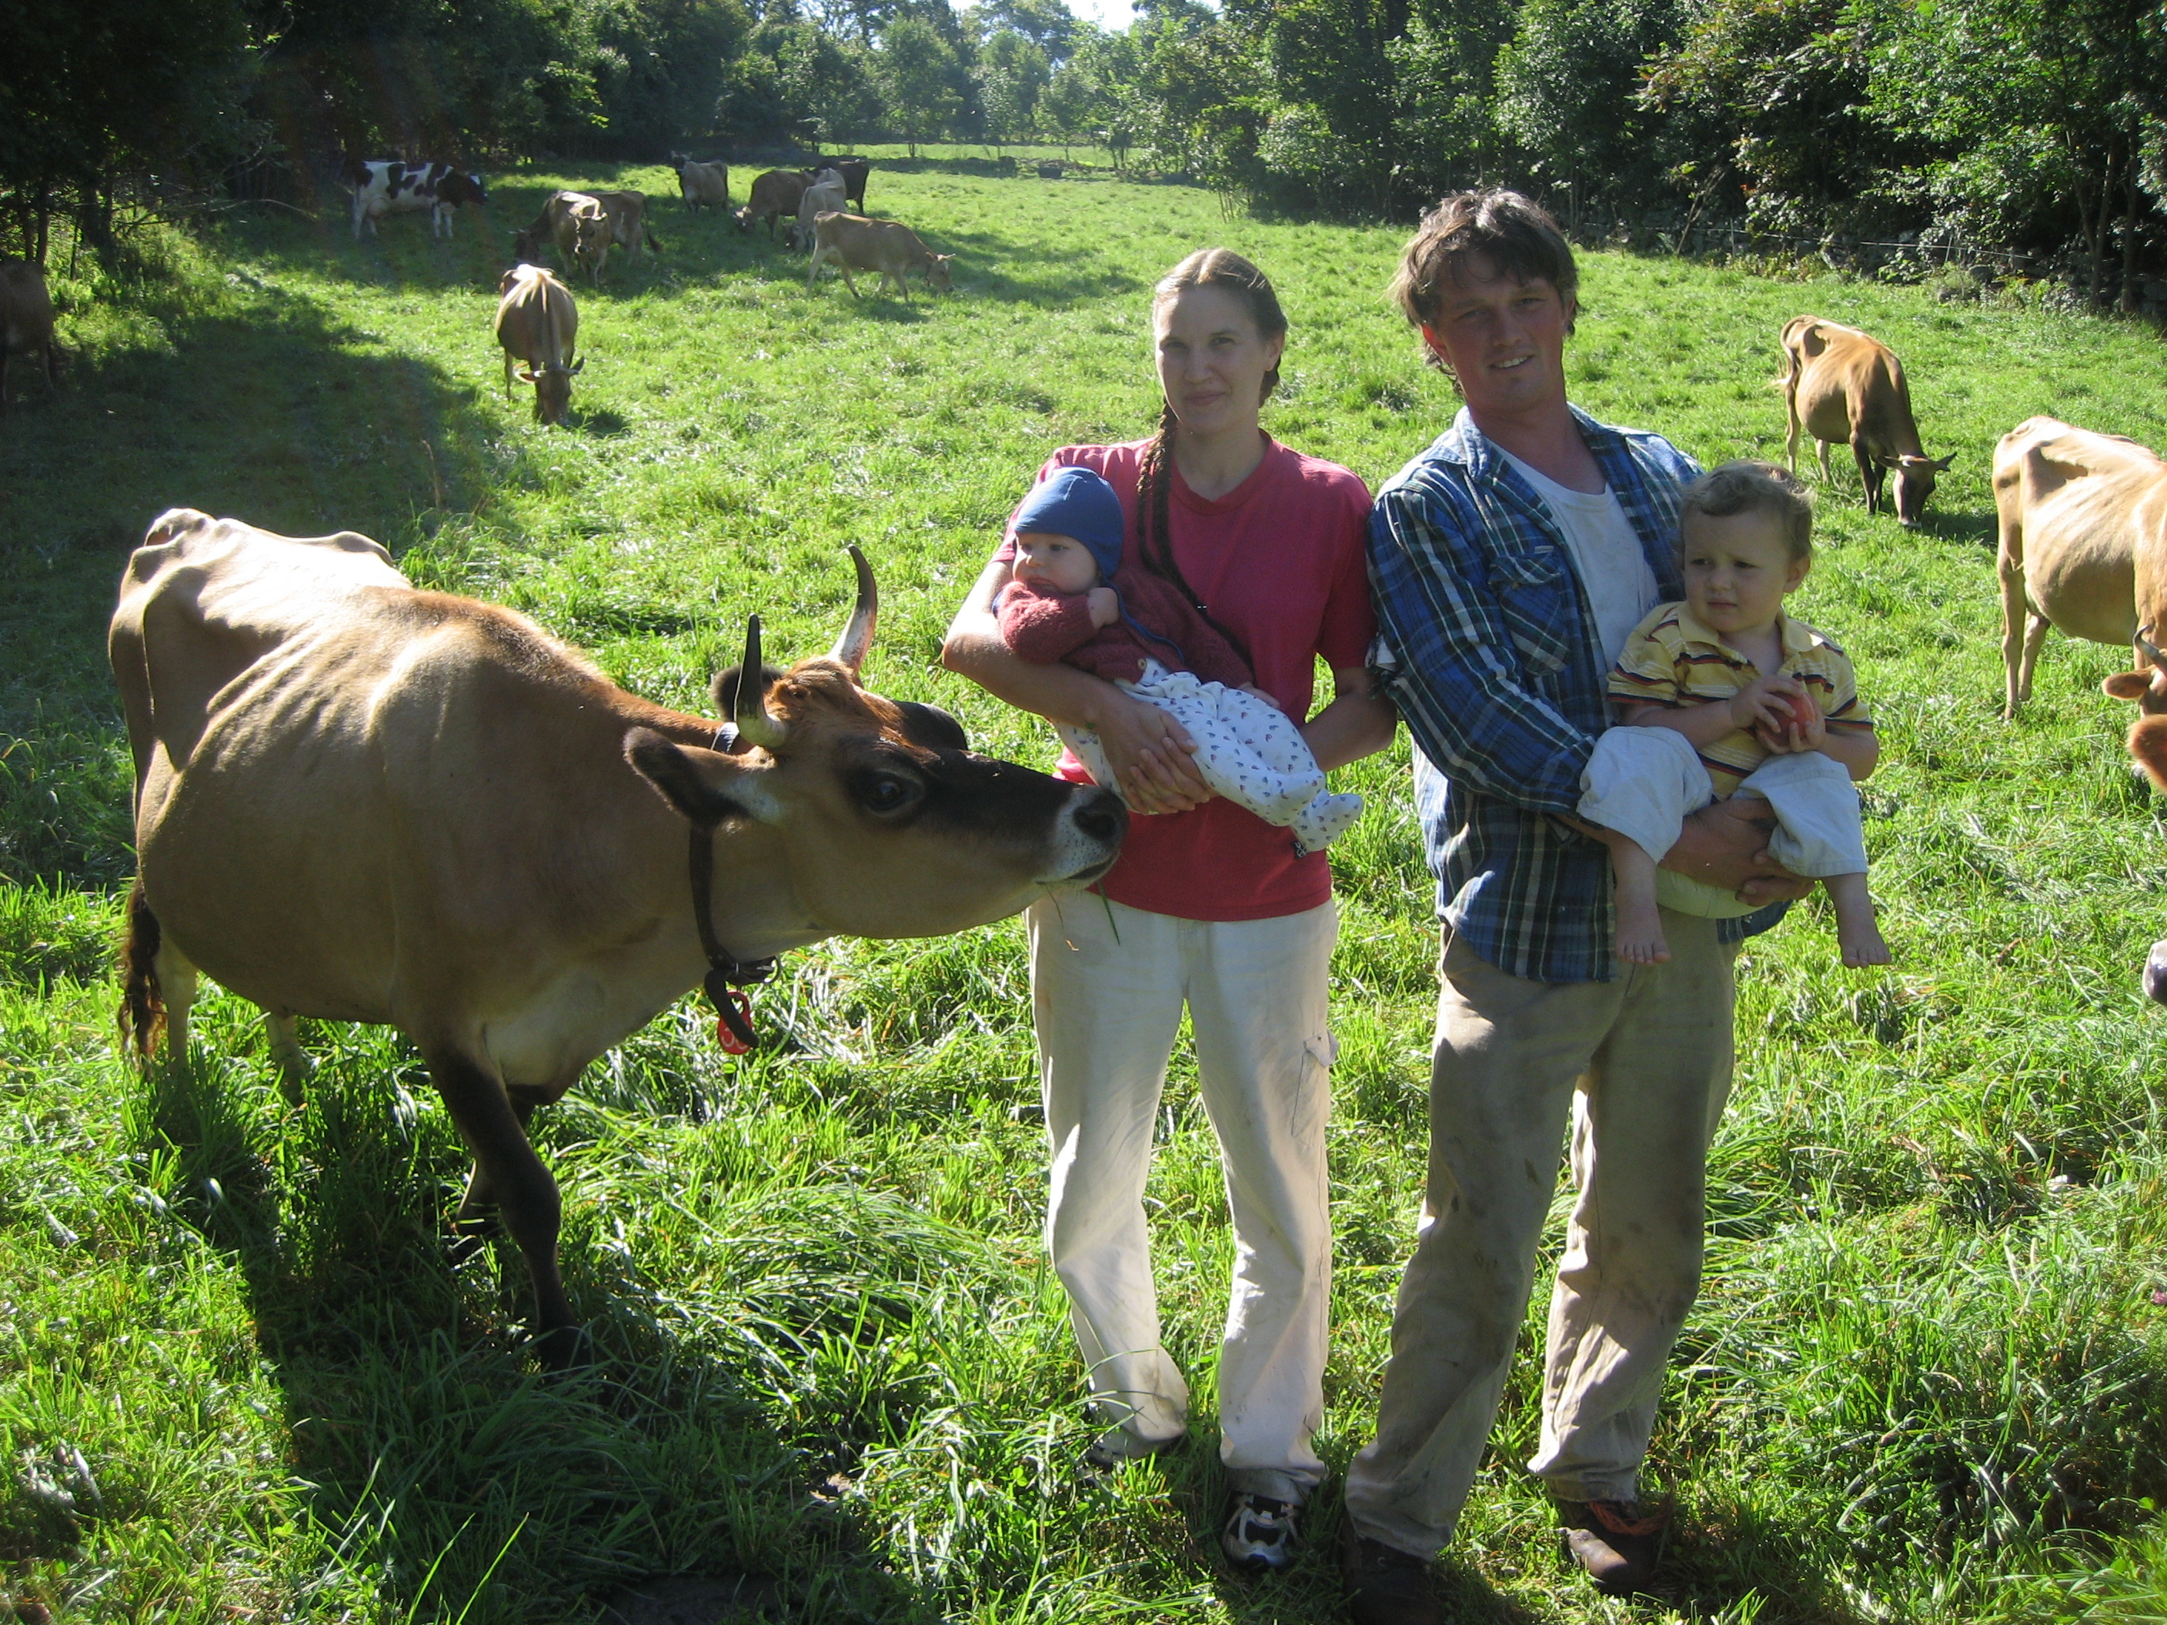
Misty Brook Farm, MA

Slide 29
Misty Brook Highlights
100% grassfed, raw milk dairy center of operations
Also produce veal, beef, pork, turkey, chicken, eggs
Grains, beans, vegetables, berries, flowers
Offer Whole Diet CSA & honor system farmstand
High Intensity, Short Duration Grazing
Limited equipment, all used, some draft power
Customer financed home purchase

