Slide 1
Climate Change & ‘Resilient’ Agriculture
What Farmers, Ranchers, & Eaters Can Do About It
By Rebecca Thistlethwaite
10/16/2015

Slide 2
The Key Message
Agriculture is both a cause of changes in the climate and a great mitigator.
Whether or not you believe in human-induced climate change, there are win-win solutions for agriculture when innovating and adapting to climate change.
Creating a resilient agricultural system is the only way forward and brings about multiple benefits.

Slide 3
Scary Stats
Agriculture in all its forms is responsible for 9-12% of total anthropogenic emissions- mainly Carbon Dioxide (CO₂) Nitrous Oxide (N₂O), & Methane (CH₄)
Ag accounts for ~50% of anthropogenic CH₄ and ~70% of anthropogenic N₂O
Soil is the best sink for carbon, yet global soil loss is around 75 billion tons of soil each year and tillage, N fertilization, & other practices burn up much of the remaining carbon

Slide 4
Regional Changes
Rainfall Amounts & Distribution
Snowpack & Glaciers
Streamflow, Water Temps & Fish Runs
Wildfire Regimes, Extent, & Intensities
Temperatures & Degree Days
Plant Growth, Fruiting, & Seeding
Pests, Disease, & Invasives
Pollination

Slide 5
Warmer/less snowpack winters, warmer/wetter springs, warmer/dryer summers
Higher water flows in winter (more rain, less snow mix) and lower in summer
1-4 week earlier spring snowmelt; also 2-6 weeks earlier harvest for many crops
½ of all sockeye migrating up Columbia perished in 2015 due to water temps that were 2-4° C higher
69% of OR counties & 100% of WA counties declared drought in 2015
All 5 counties of the Gorge had a drought declaration in 2015

Slide 6
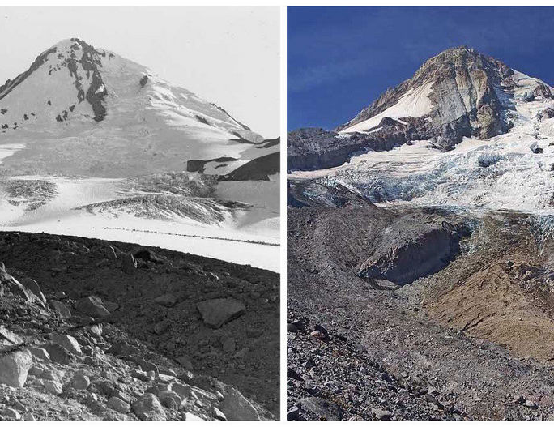
Notes:
Elliot glacier on Mt. Hood 100 years ago and today

Slide 7
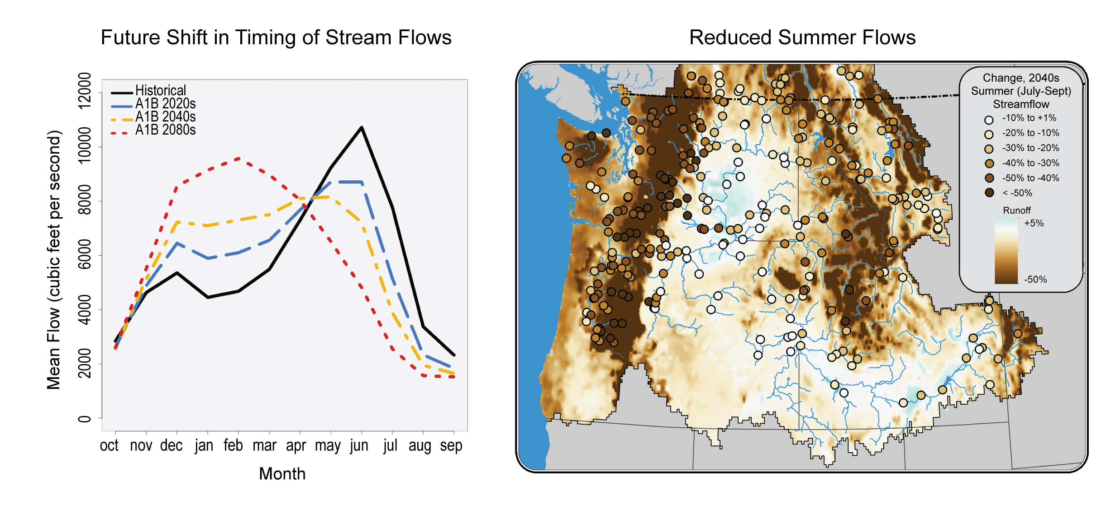

Slide 8
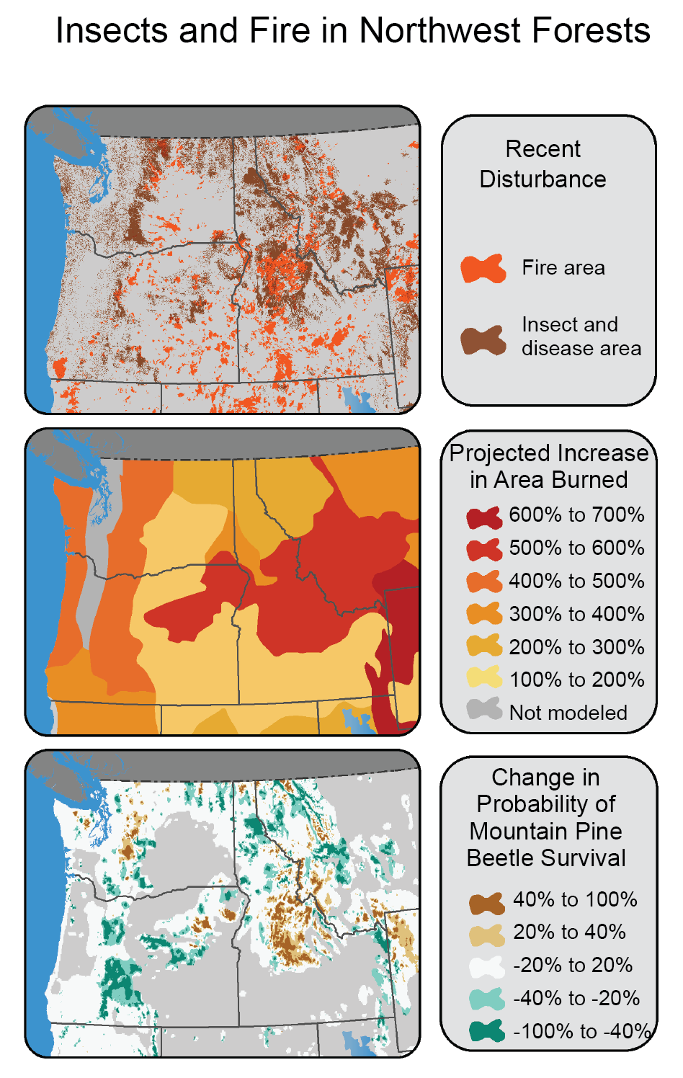

Slide 9
The full-on model of industrial agriculture — meaning replacement of ecosystem services, diversity, and human labor with fossil fuels and other chemicals — has been degrading the landscape to a point where resilience has been undermined. Agri-culture has become Agri-business, but at what cost?

Slide 10
‘Resilient Agriculture’
Characteristics of resilient food systems is that they are supported by the natural resources of a particular region — the food system doesn't import significant resources or export waste. It is about much more than just bouncing back when things go wrong. It is a much richer idea that involves careful cultivation of community assets.
In order for this to work, agriculture must be reasonably profitable and diversified. Success in any one measure alone does not mean agriculture is resilient: An agriculture that causes widespread environmental crises or degrades human health is not resilient, no matter how economically successful or how much food is produced, making its profitability and productivity irrelevant

Slide 11
Cultivating “Resiliency”
One, a capacity to respond to a disturbance to avoid or reduce damage to the existing system.
Two, a capacity to recover from damaging events.
And three, a capacity to transform or change the existing system to one that is more resilient to disturbance.
From Laura Lengnick, Resilient Agriculture

Slide 12
Resilient Agricultural Practices
Encourage Diversity (spatially & temporally)
Crop Rotations, Cover Crops, Reduce Tillage
Fertilizer Management, Precision Agriculture
Reduce Food Waste (& return to soil)
Prevent Erosion, Reduce Soil Loss
Adjust Irrigation Practices & Upgrade Equipment
Dry Farming/Fallowing Systems
Build Soil Organic Matter/Capture Carbon

Slide 13
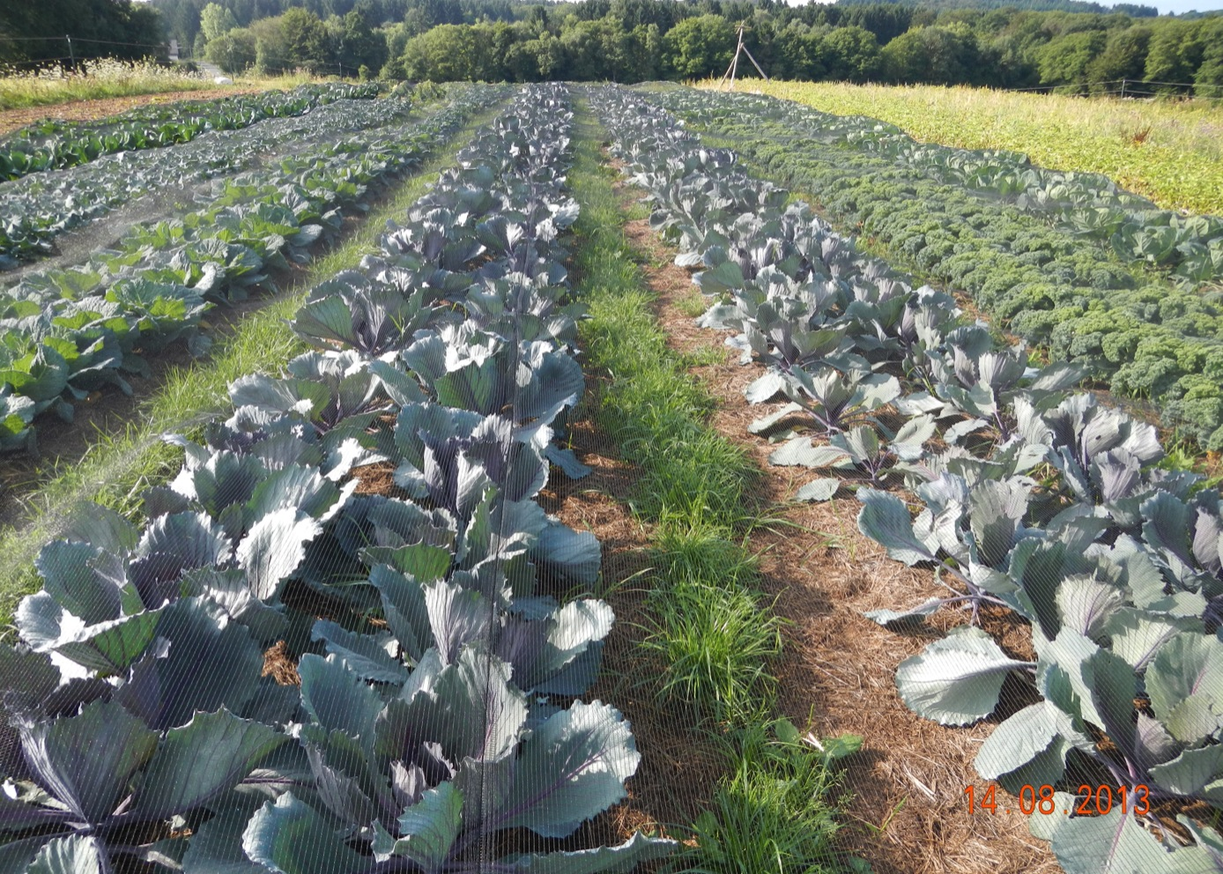
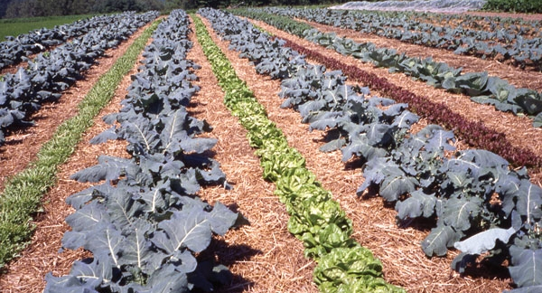
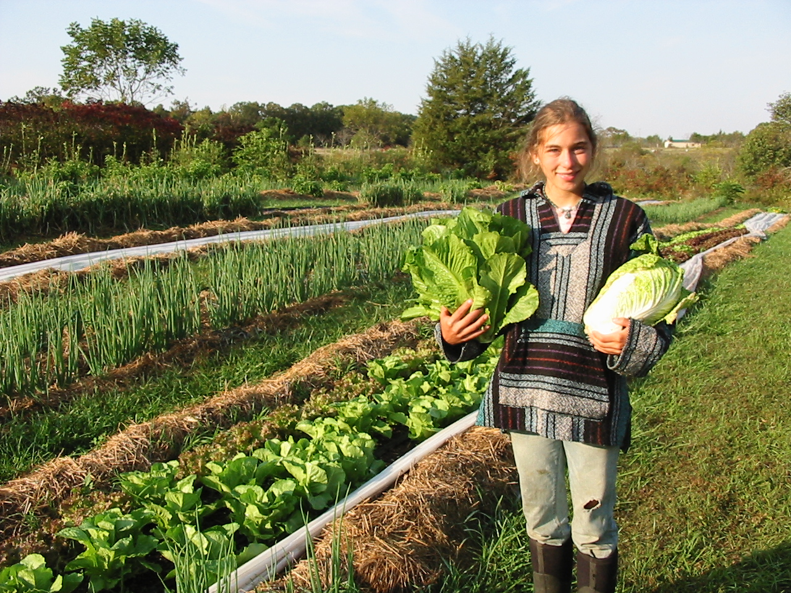

Slide 14
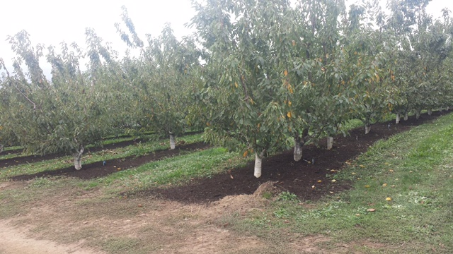


Slide 15
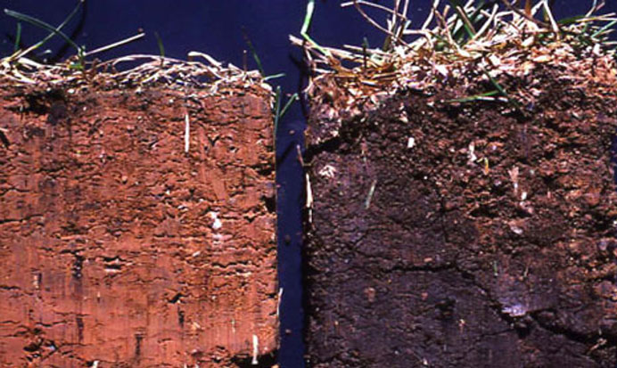

Slide 16
More Good Practices
Managed, Rotational, Multi-species Grazing
Agroforestry (shade, windbreaks, lumber, fodder, etc)
Perennial Agriculture
Season Extension
Reduce Fuel & Practice Energy Conservation
Draft Animal Power & Alternative Energy Sources
Work With Nature, Not Against It

Slide 17
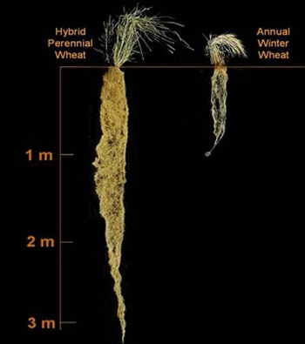
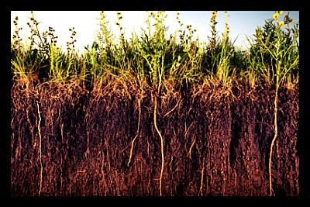

Slide 18
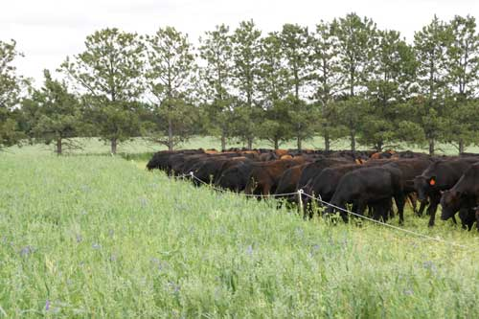
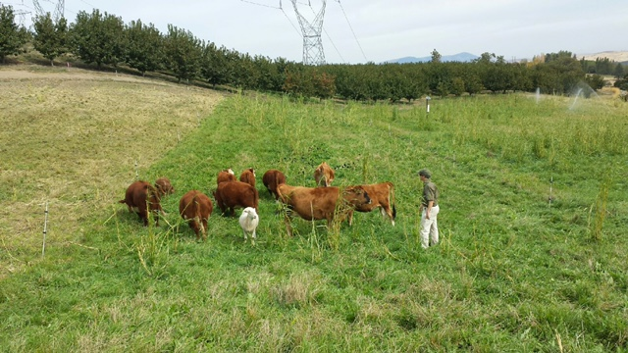

Slide 19
Since the advent of agriculture, humanity has been moving carbon in the wrong direction—out of the soils and into the atmosphere. We plow and have a tendency to mismanage livestock leaving land bare for much of the year, exposing soil life and humus to sunlight, desiccation, and oxidation. On bare ground, photosynthetic energy necessary for humification is not harvested. We make matters worse by using synthetic fertilizers, thereby seriously inhibiting the flow of energy to fungi that make stable, carbon-sequestering molecules and stimulating growth in certain bacterial populations destructive to soil fungi. And of course, we emit massive amounts of carbon from burning fossil fuels and moving food around the globe. These kinds of decisions may have seemed right at the time, but now we know that they are leading us to a soil and climate catastrophe.
-Savory Institute

Slide 20
By renewing the relationship of grazing animals to grasslands, long-term storage of carbon in soils will remove carbon from the atmosphere and add vast quantities of carbon to soil organic matter. It can also make the water cycle more effective by storing water in the best place- the soil.
-Savory Institute

Slide 21
What Can Eaters Do?
Support biodiverse farmers & eat their diversity
Eat grassfed, pasture-raised, & forest-fed animal products
Learn to eat seasonally & can/ferment/freeze the rest
Buy dry-farmed crops & lower water crops
Buy organic or from farmers who practice soil carbon farming
Buy from animal-powered or alternative energy farms
Plant trees, garden, & use alt energy yourself!
Join a CSA, be part of the Interdependence
Get involved- vote, volunteer, voice

